Slide 1
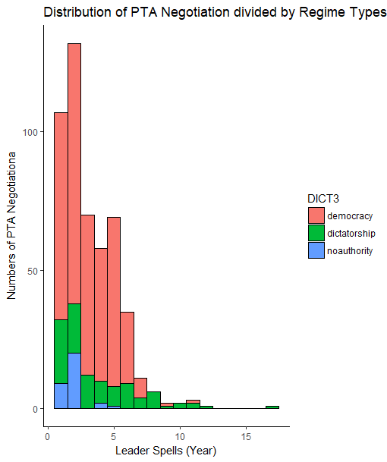
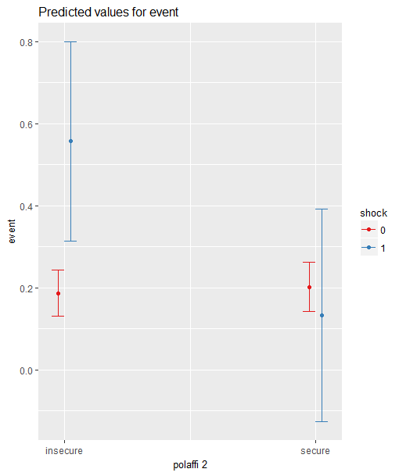
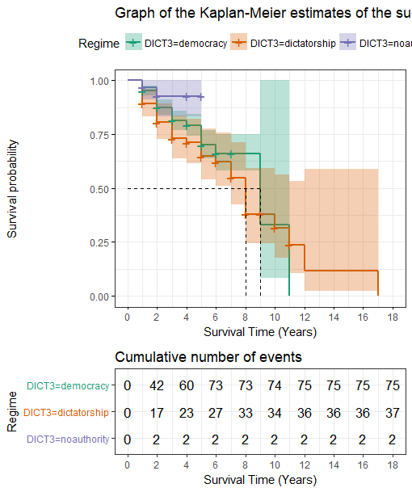

When will Leaders Negotiate South-North PTA?
Lucie Lu Department of Political Science, University of Illinois at Urbana-Champaign
INTRODUCTION
Preferential trade agreements (PTAs) are binding international treaties that help states to foster trade and economic integration among member-states.
Current literature on the preferential trade agreement mainly focuses on the effects of this institution.
The desired economic purposes PTAs have achieved
Explain why states form the PTAs
The political purposes of the leaders in the developing countries to sign trade treaties are currently understudied.
ARGUMENTS
The leaders in the developing countries choose to sign the PTAs to lock in the economic reforms for the primary goal of political survival.
When a leader is threatened by the opposition, in the hope of using liberalized reform to consolidate his power, a leader can use PTA to facilitate the liberal reforms originally curtailed by the domestic opposition.
RESEARCH QUESTION
Under what conditions will leaders in the developing countries negotiate the South-North Preferential Trade Agreements with required structural economic reforms?
HYPOTHESIS
Insecureness PTA Negotiation
RESULTS
MOTIVATIONS
Government also sign PTAs for domestic political reasons. This paper focuses on the strategic behaviors of leaders to form PTAs to consolidate their power vis-à-vis the opposition.
THEORY
When leaders of developing countries negotiate PTAs with developed countries, they anticipate a forthcoming structural economic transformation.
However, domestic economic reforms usually provoke controversy and organized opposition.
PTA is an effective instrument for promoting economic reform.
What motivates leaders to participate in this costly game? When is the optimal time to do so?
Fig. 1. Distribution of PTA negotiation by regime types.
Fig. 3. Prediction of PTA negotiation probability.
PRELIMINARY CONCLUSIONS
Holding leaders’ tenure constant, on average, without insecure shocks, leader’s probability of negotiating a PTA is around 20%.
Comparing to an insecure leader, an insecure leader with shocks has 30% higher probability of negotiating a PTA.
Comparing to an secure leader, a secure leader with an insecure shock has relatively lower probability of negotiating a PTA, with a large confidence interval.
RESEARCH DESIGN
Quasi-experiment
Treatment: leaders with insecure shocks
Developed new measurement of secureness of leaders: The dataset covers 497 leader-spells in the period 1995 to 2015.
Compares the likelihoods of different types of leaders to negotiate South-North PTAs.
Secure leaders | Secure leaders with insecure shocks
Insecure leaders | Insecure leaders with insecure shocks
Fig. 2. The Kaplan-Meier estimation of PTA negotiation rates.

